Slide 1
Kronos 8.1
Workforce Time Keeper
Cleveland State University
Hourly employees clock in

Slide 2

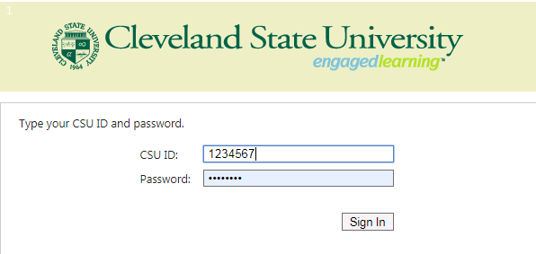
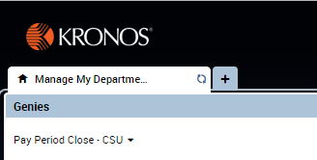
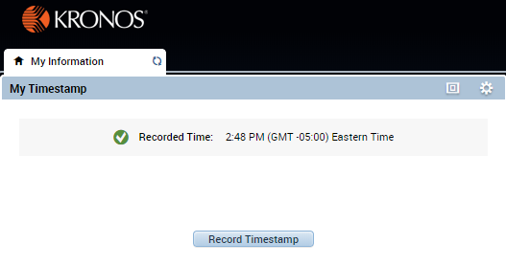
myTime
Classified/Student Hourly (Biweekly)
Log on to myTime.
Open your web browser, navigate to CSUOHIO.EDU, and click the MYCSU tab.
Click on Employee Self-Service in the blue column and select myTime.
Enter your CSU ID and password, then click the Sign In box.
3
1
4
Supervisors: access the My Information tab (non supervisors skip this step).
In the top left corner, click the plus sign next to the Manage My Department tab.
Select My Information from the list.
Record your Timestamp (Single Job).
Click Record Timestamp. The Timestamp will be displayed.

Slide 3
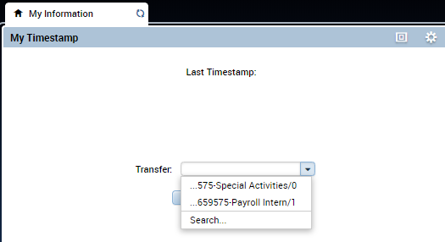
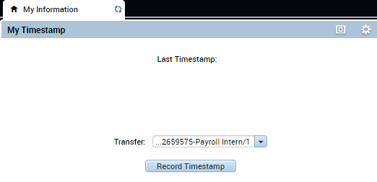
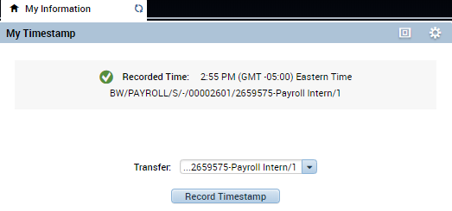
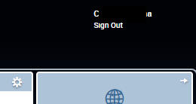
myTime
Classified/Student Hourly (Biweekly) continued
Record your Timestamp (Multiple Jobs).
Click the drop down arrow on the Transfer box to see the list of your jobs. Select the correct job.
Click Record Timestamp. The Timestamp for the job you selected will be displayed.
Exit myTime.
Click the Sign Out link below your name in the top right corner.

Slide 4


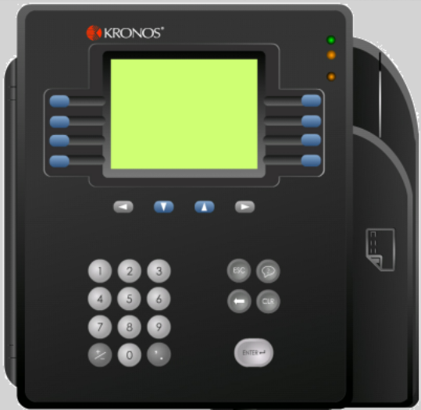
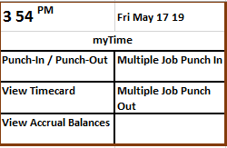
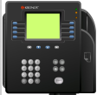
myTime
Time Clock
Soft Keys
Soft keys are used to perform functions using the Time Clock.
Status Indicator Lights
The green light notifies the employee the punch was accepted at the Timekeeper Terminal.
An orange light notifies the employee the punch was not been accepted at the Timekeeper Terminal.
Multi-Job Select
View Timecard
View Accrual
Balances
Badge Reader
Clock Display
Displays current date, time and soft key labels. When a punch is successful the employee’s name or ID number is displayed. If a punch is unsuccessful an error message displays.
Navigation Keys
Navigation keys are used to move within fields and scroll through lists.
Additional Keys
The Escape, Help, Backspace, Clear and Enter keys are used in conjunction with different soft key tasks.
Numeric Key Pad
The key pad is used for data entry when performing functions and transactions at the terminal.
How to Punch In or Out (Single Job)
1
Press the Punch-In/Punch-Out soft key.
2
Hold the badge so that the black stripe is facing the badge reader, swipe the badge through the reader from top to bottom to record a punch.
If the punch is successful, the top status light flashes green and you hear a single beep.
If the punch is rejected, the middle status light flashes orange and you hear three quick beeps. Look for an error message on the clock display.

Slide 5
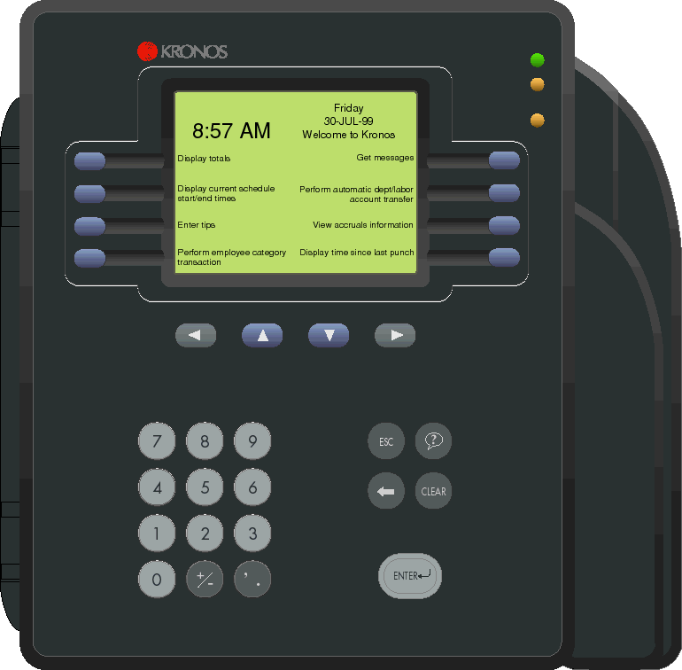
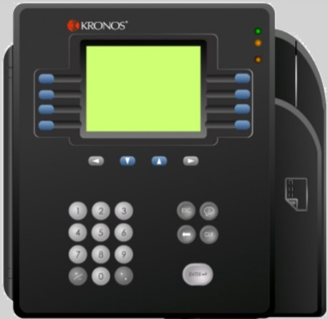

myTime
Time Clock - continued
Tips & Recommendations
Accrual totals such as sick and vacation time can be viewed at the Timekeeper Terminal.
Multi-Job Select
View Timecard
If black up and down arrows are displayed on the terminal screen, use the Up and Down arrow keys to view more information.
View Accrual
Balances
Some transactions include a scroll bar. Use the Up and Down arrow keys to move the scroll bar.
How to Punch In or Out (Multiple Jobs)
1
Press the Multiple Job Punch In soft key.
Multiple Job employees only need to select a job when punching in. They do not select a job when punching out.
2
Swipe the badge through the reader from top to bottom.
3
Your jobs will display with your CSU ID and your job title. Use the scroll keys to select the correct job.
4
Press Enter.
5
To punch out, press the Multiple Job Punch Out soft key then Enter.
How to View Timecard & Accrual Balances Information
Employees can view timecard and accrual information at the time clock.
1
Press the corresponding blue soft key.
Punch-In/Punch-Out
View Timecard
View Accrual
Balances
2
Swipe the badge through the badge reader from top to bottom.
The information displays on the screen. Use the navigation keys to scroll through information.

